Slide 1
Online Voting system Using Face Recognition
Advisor: Dr. Kashif Ishaq

Slide 2
THE TEAM
Muhammad Tazeem Sajid
F2019065042
Hamza Mudassir
S2020105012
Sohaib Naveed
F2019105092
Ghulam Mustafa
F2019065103
Team

Slide 3
CONTENT
Problem Statement
Existing Project
Solution of Problem
About Project
Scope Of Project
Tool Technologies

Slide 4
P
ART ONE
Problem Statement

Slide 5
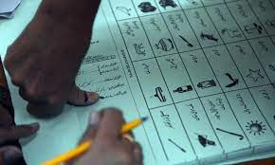
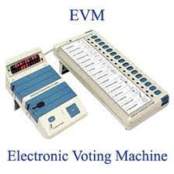
PROBLEM

Slide 6
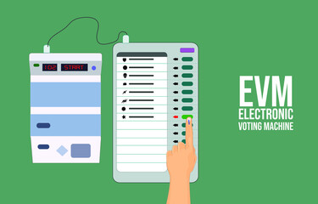
PROBLEM WITH EVM
        Lack of Transparency
        Security Concerns
        Technical Failures
        Cost
        Accessibility
.

Slide 7
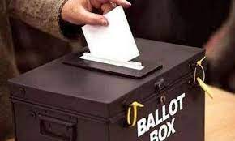
PROBLEM WITH BALLOT PAPER
        Cost
        Voter Error
        Inaccuracies
        Accessibility
        Corruption
.

Slide 8
P
ART TWO
Solution

Slide 9
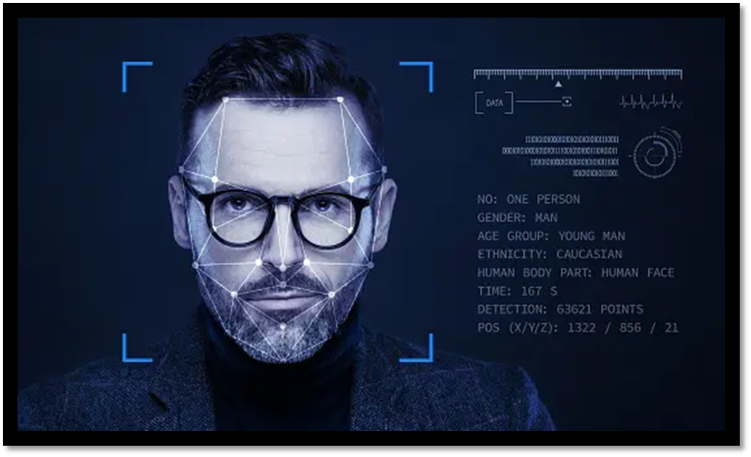
SOLUTION OF THE PROBLEM
FACIAL RECOGNITION TECHNOLOGY

Slide 10

ABOUT PROJECT
An online voting system using face recognition technology is an innovative approach to conducting secure and accessible elections. The system incorporates facial recognition technology to authenticate voters, preventing fraud and ensuring that only eligible voters can cast their votes.
.

Slide 11
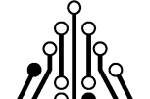
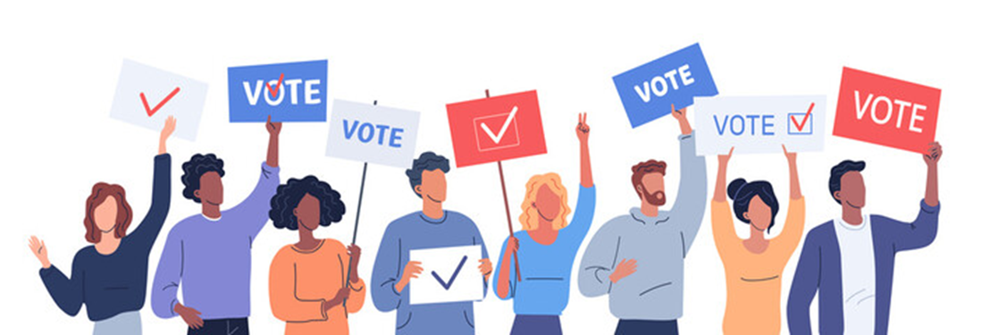
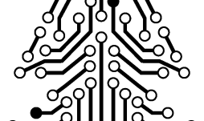
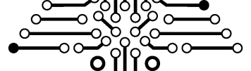
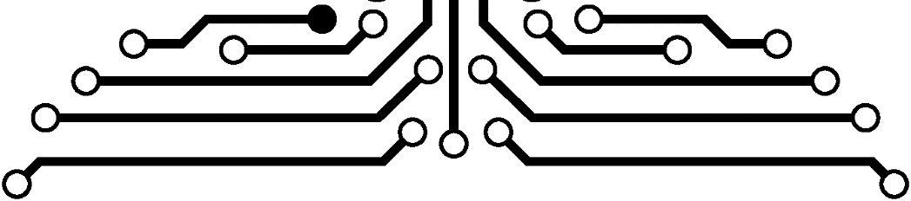
ARCHITECTURE
USER INTERFACE
VOTING MODEL
FACIAL RECOGNITION MODEL

Slide 12
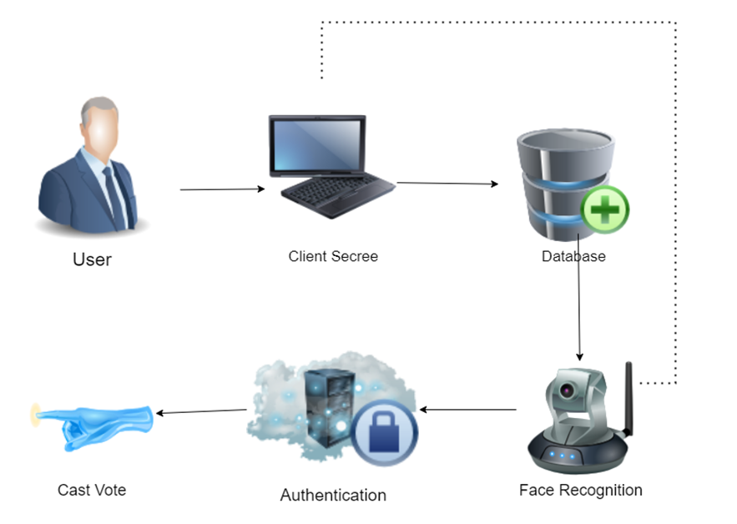
WORKING OF PROJECT
?

Slide 13

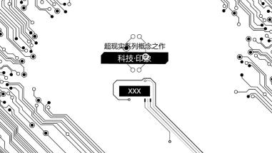
SCOPE OF PROJECT
  System Design and Development
  Voter Registration and Authentication
  Ballot Creation and Voting
  Security and Privacy
  Testing and Evaluation
  Legal and Regulatory Compliance.

Slide 14
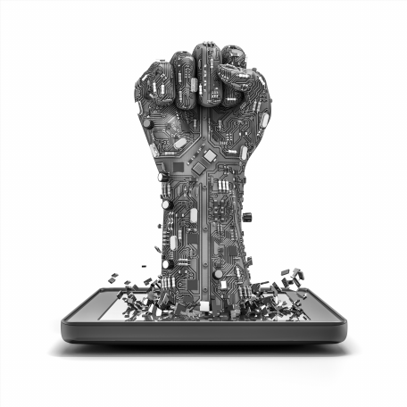

Beneficial's
Voters
Political Parties
Government
Technology Provider
Candidates
Election Official’s

Slide 15
TOOL TECHNOLOGIE’S
Programming Languages:
The system may be developed using programming languages NodeJS, JScript, React, boot strap.
2.Database Management System:
A secure database management system Mongo DB will be used to store voter information and voting records.
3.Security Measures:
The system will require various security measures such as encryption, secure authentication(2 factor ), and firewalls to prevent hacking, tampering, or unauthorized access.
4.Testing Frameworks:
The system will require testing frameworks such as Selenium, Pytest, or Unittest to ensure the accuracy, reliability, and usability of the system.
5.Hardware:
Mobile and computer with better data connection required

Slide 16
THANKS!
tazeemsajid22@gmail.com

